Slide 1
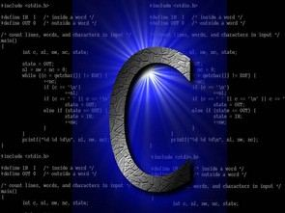
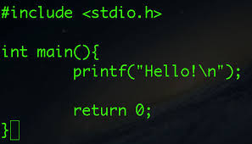
Introduction to Scientific and Engineering Computation
BIL105E

Slide 2
CONTACT INFORMATION
Instructor: Bora Döken
E-mail: dokenb@itu.edu.tr

Slide 3
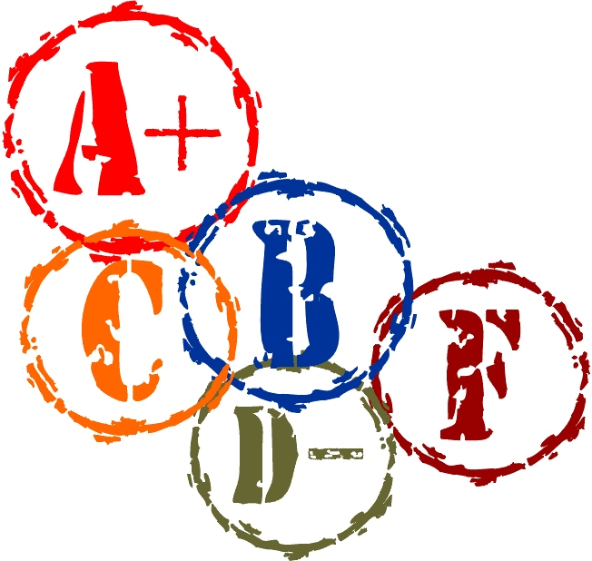
Grading & Attendance
Grading Method
Two Midterm Exams: %25 (each)
One Homework %10
Final Exam: %40
Attendance %50

Slide 4
COURSE INFORMATION
Text Books:
How To Program C, H.M. Deitel and P.J. Deitel, Prentice-Hall Inc., 2001
Web Pages:
https://www.programiz.com/c-programming#tutorial
https://www.sitesbay.com/cprogramming/index
Editor & Compiler Software:
http://www.bloodshed.net/download.html

Slide 5
1
Introduction

Slide 6
1.1 Introduction
We will learn
The C programming language
Structured programming and proper programming techniques
This course is appropriate for
Technically oriented people with little or no programming experience

Slide 7
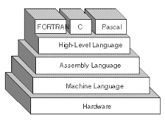
1.2 Machine Languages, Assembly Languages, and High-level Languages
Three types of programming languages
Machine languages
Strings of numbers giving machine specific instructions
Example:
10010111
00110001
10001111
Assembly languages
English-like abbreviations representing elementary computer operations (translated via assemblers)
Example:
LOAD BASEPAY
ADD OVERPAY
STORE GROSSPAY

Slide 8
1.3 Machine Languages, Assembly Languages, and High-level Languages
Three types of programming languages (continued)
High-level languages
Codes similar to everyday English
Use mathematical notations (translated via compilers)
Example:
grossPay = basePay + overTimePay

Slide 9
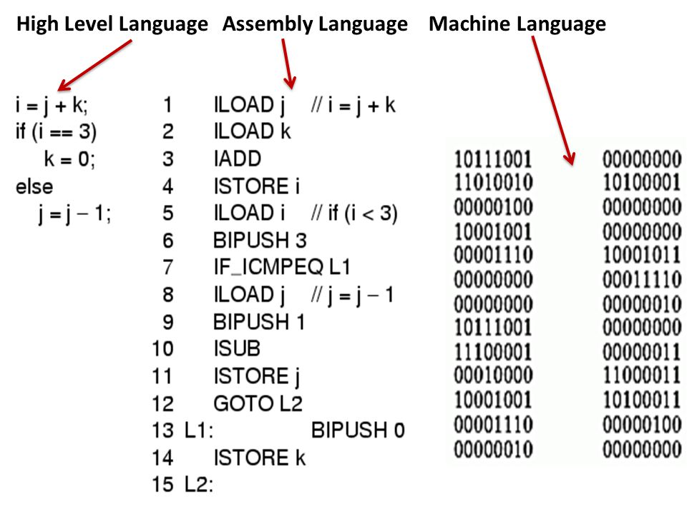

Slide 10
1.4 History of C
C
Evolved by Ritchie from two previous programming languages, BCPL and B
Used to develop UNIX
Used to write modern operating systems
Hardware independent (portable)
By late 1970's C had evolved to "Traditional C"
Standardization
Many slight variations of C existed, and were incompatible
Committee formed to create a "unambiguous, machine-independent" definition
Standard created in 1989, updated in 1999

Slide 11
1.5 C++
C++
Superset of C developed by Bjarne Stroustrup at Bell Labs
"Spruces up" C, and provides object-oriented capabilities
Dominant language in industry and academia
Learning C++
Because C++ includes C, some feel it is best to master C, then learn C++

Slide 12
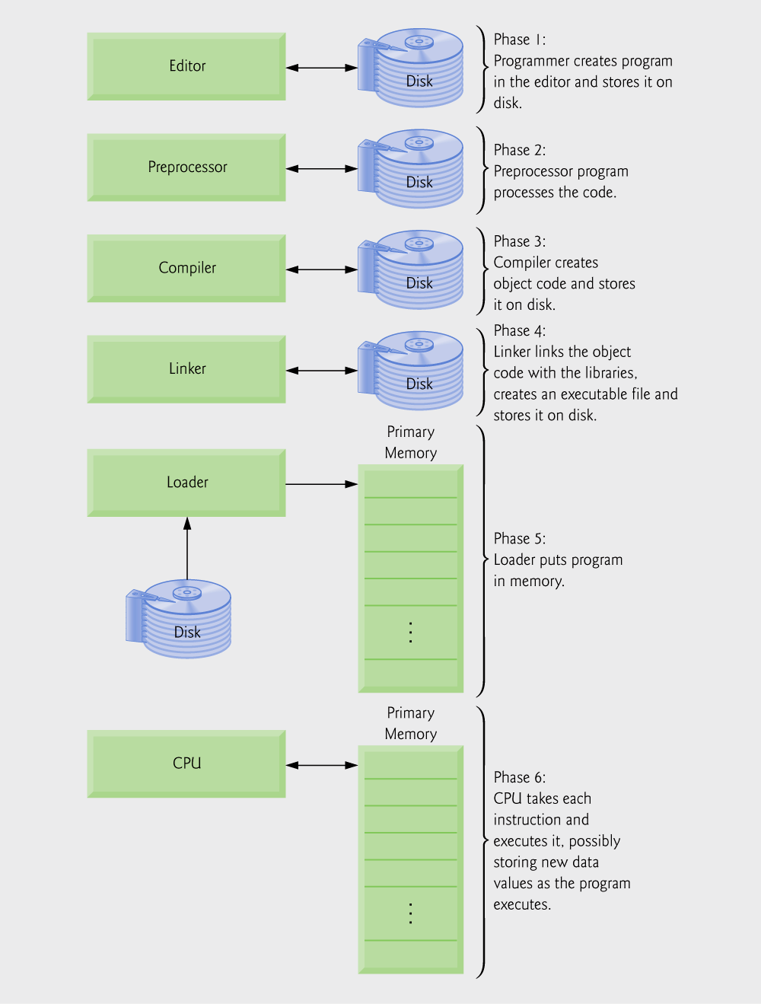
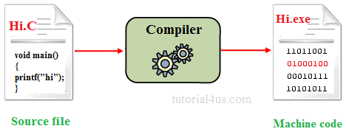
1.6 Typical C Program Development Environment
Phases of C Programs:
Edit
Preprocess
Compile
Link
Load
Execute
The preprocessors are the directives, which give instructions to the compiler to preprocess the information before actual compilation starts.
Fig. 1.1 | Typical C development environment.

Slide 13
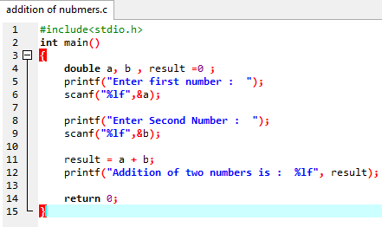

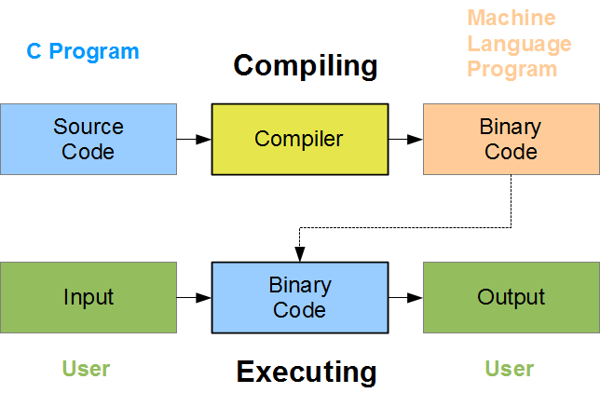

Slide 14
C compiler
Compiler
Programmer can use high level language such as C
CPU knows machine language (assembly language)
C compiler
Commercial compiler: Microsoft Visual C/C++ (ver. 6.0)
Free compiler: gcc
C program
int main…
Compiler
Machine
language
010101…

Slide 15
Compiler & Editor Software Web Address
http://www.bloodshed.net/download.html

